Slide 1
Machine learning
Presented By:-
Akash Jadhav(1403057)
Omkar Kadam(1501056)
Rupesh Sharma(1505053)

Slide 2
Topics
Support Vector Machine(SVM)
K Nearest Neighbours(KNN)
Linear Regression

Slide 3
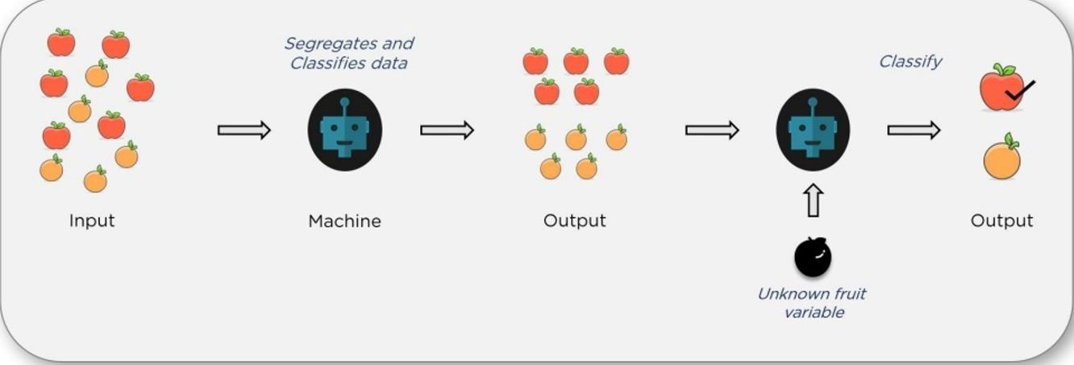
Support Vector Machine(SVM)
Support vector machine is type of algorithm which classifies the elements on the basis of its features.
SVM will classify any new element into one of the two classes.

Slide 4
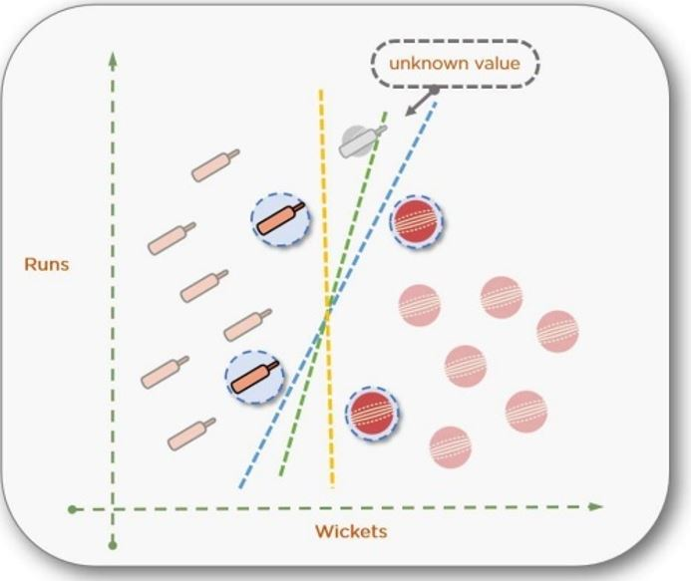
2D SVM
The best line is selected by computing the max margin from equidistant support vectors
Support vectors are the points which are very close to a dividing line.Using support vectors we can select the best line to divide the data.

Slide 5
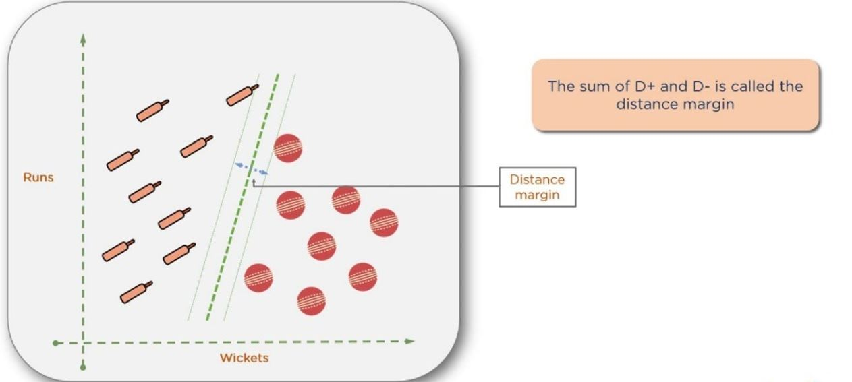
If we calculate the margin of blue and yellow line it is minimum
But green line has more margin compared to other two. And it divides the data perfectly because the margin between two support vectors is maximum.Using the green line new player will be classified as batsman.
The dividing line is technically called as hyperplane

Slide 6
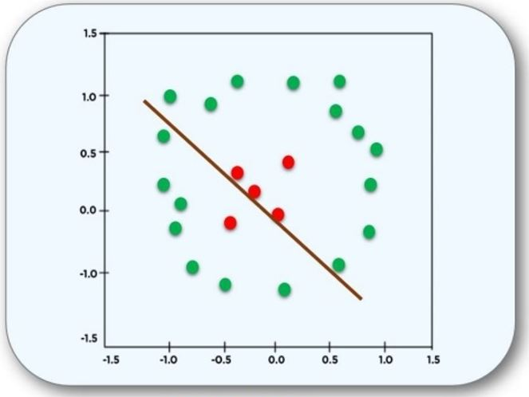
3D SVM
What if data cannot be separated by line?
There is no clear separation between data and the points are misclassified.

Slide 7
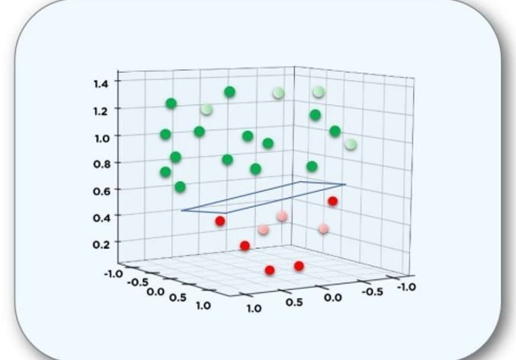
SVM uses kernel method to convert 2D into 3D.
2D => Kernel => 3D
Once the data is converted into 3D the SVM separates data using 2D plane.
More than 3D?????

Slide 8
Pros & Cons
Advantages:
Accuracy
Works well on smaller cleaner datasets
It can be more efficient because it uses a subset of training points
Disadvantages:
Isn’t suited to larger datasets as the training time with SVMs can be high
Less effective on noisier datasets with overlapping classes

Slide 9
Applications:-
Face Detection
Text Recognition
Image classification
Bioinformatics

Slide 10
K Nearest Neighbours
Simple analogy...Tell me about your friends and i will tell you who you are..
A powerful classification algorithm used to pattern recognition
K nearest neighbours stores all available cases and classifies
New cases based on similarity measures
Select the K nearest examples to E to train the dataset.

Slide 11
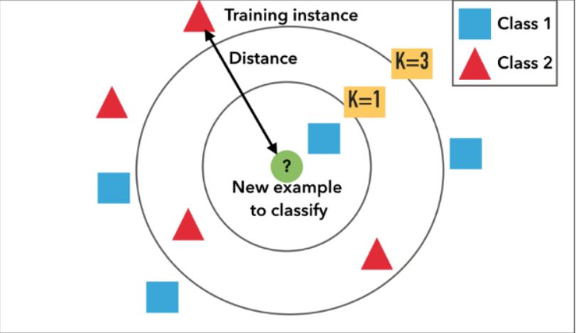
KNN Algorithm is based on feature similarity: How closely out-of-sample features resemble our training set determines how we classify a given data point:

Slide 12
STEPS FOR KNN:-
A positive integer k is specified, along with a new sample
We select the k entries in our database which are closest to the new sample
We find the most common classification of these entries
This is the classification we give to the new sample

Slide 13
Pros & Cons
Advantages
Non-parametric architecture
Simple
Powerful
Requires no training time
Disadvantages
Memory intensive
Classification/estimation is slow

Slide 14
APPLICATIONS:
Credit ratings — collecting financial characteristics vs. comparing people with similar financial features to a database.
Should the bank give a loan to an individual? Would an individual default on his or her loan? Is that person closer in characteristics to people who defaulted or did not default on their loans?
In political science — classing a potential voter to a “will vote” or “will not vote”, or to “vote Democrat” or “vote Republican”.
More advance examples could include handwriting detection (like OCR), image recognition and even video recognition.

Slide 15
Linear Regression
It’s a method to predict a target variable by fitting the best linear relationship between the dependent and independent variable.
Linear Regression is a machine learning algorithm based on supervised learning.
It performs a regression task. Regression models a target prediction value based on independent variables.
It is mostly used for finding out the relationship between variables and forecasting.

Slide 16
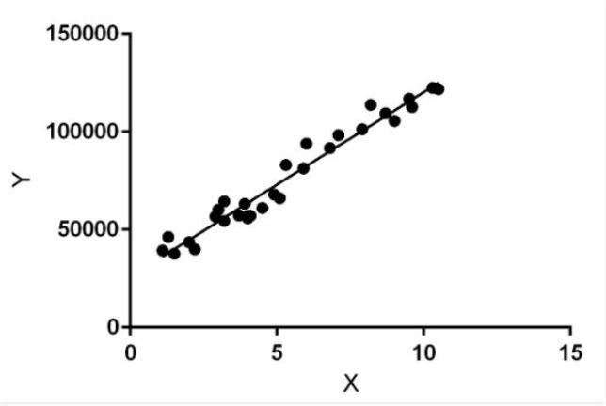
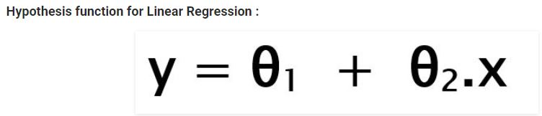
Linear regression performs the task to predict a dependent variable value (y) based on a given independent variable (x).
So, this regression technique finds out a linear relationship between x (input) and y (output). Hence, the name is Linear Regression.
In the figure, X (input) is the work experience and Y (output) is the salary of a person.
The regression line is the best fit line for our model.
x: input training data
y: labels to data (supervised learning)
θ1: intercept
θ2: coefficient of x

Slide 17
Simple Linear Regression
With simple linear regression when we have a single input, we can use statistics to estimate the coefficients.
This requires that you calculate statistical properties from the data such as means, standard deviations, correlations and covariance
Ordinary Least Squares
When we have more than one input we can use Ordinary Least Squares to estimate the values of the coefficients.
The Ordinary Least squares procedure seeks to minimize the sum of the squared residuals. This means that given a regression line through the data we calculate the distance from each data point to the regression line, square it, and sum all of the squared errors together.

Slide 18
Gradient Descent
When there are one or more inputs you can use a process of optimizing the values of the coefficients by iteratively minimizing the error of the model on your training data.
Regularization
There are extensions of the training of the linear model called regularization methods. These seek to both minimize the sum of the squared error of the model on the training data (using ordinary least squares) but also to reduce the complexity of the model

Slide 19
Pros & Cons
Advantages:
Linear regression is an extremely simple method.
No tuning required
Highly interpretable
Well-understood
Disadvantages:
If we have a number of parameters than the number of samples available then the model starts to model the noise rather than the relationship between the variables.
Unlikely to produce the best predictive accuracy

Slide 20


